Slide 1
STUDENT GRADEBOOK
SUBMITTED BY-
ISHIKA AVASTHI (23CSU131)
SAIYAM TANEJA (23CSU273)
SUBMITTED TO-
DR. ANURADHA DHULL

Slide 2
table of contents
Introduction
Key Features
Languages and Data Structures Used
Data Structures Used
Classes Used
Flowchart
Advantages
Future Scope

Slide 3

INTRODUCTION
A gradebook is a system used by educators to track and record students' grades and academic performance. It organizes data on assignments, exams, and assessments to monitor progress and generate reports.
The Gradebook Management System is a standalone Java application designed to streamline academic record management. It provides an intuitive interface for Admins, Teachers, and Students to manage students, subjects, assignments, and grades effectively.

Slide 4
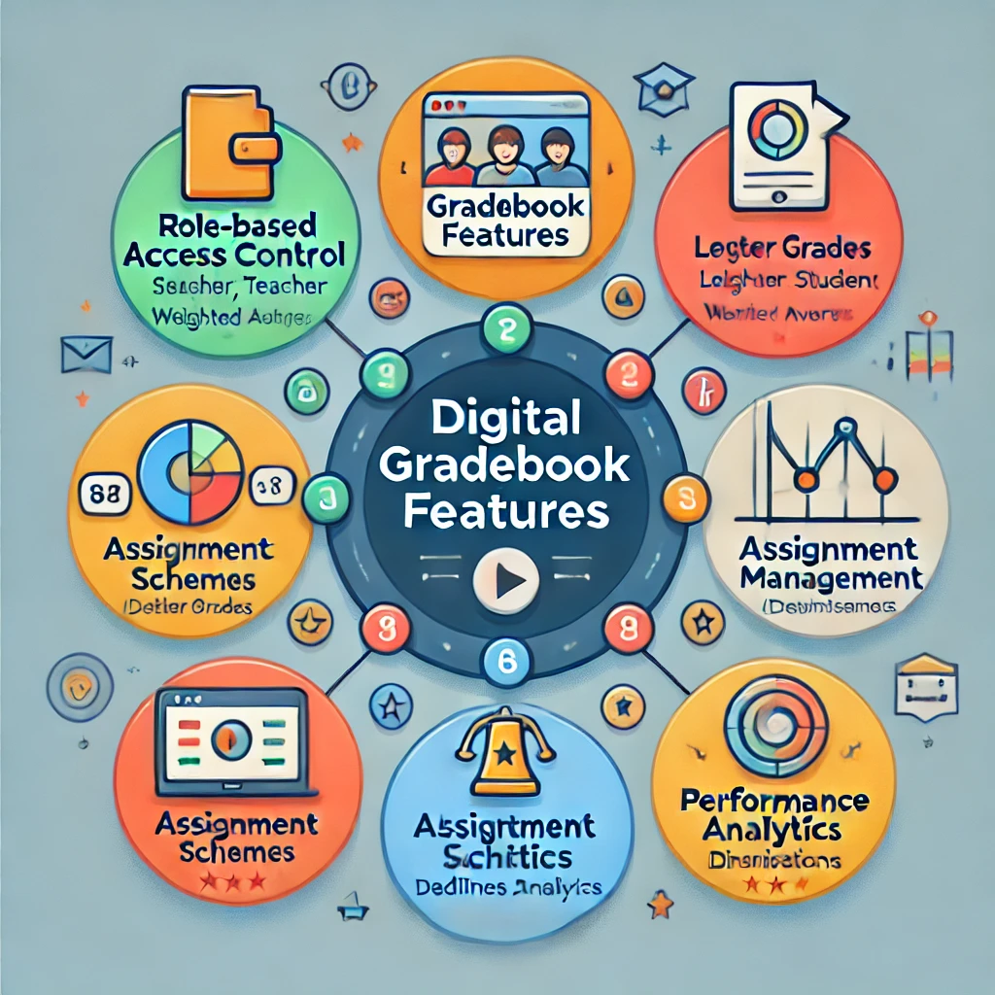
KEY FEATURE
This system supports role-based access control, grading schemes, attendance tracking, assignment management with deadlines, and performance analytics, making it a comprehensive tool for educational institutions to monitor and improve academic performance.

Slide 5
LANGUAGE AND DATA STRUCTUREs USED
JAVA
HASHMAPS
LINKEDLIST
ARRAYS

Slide 6
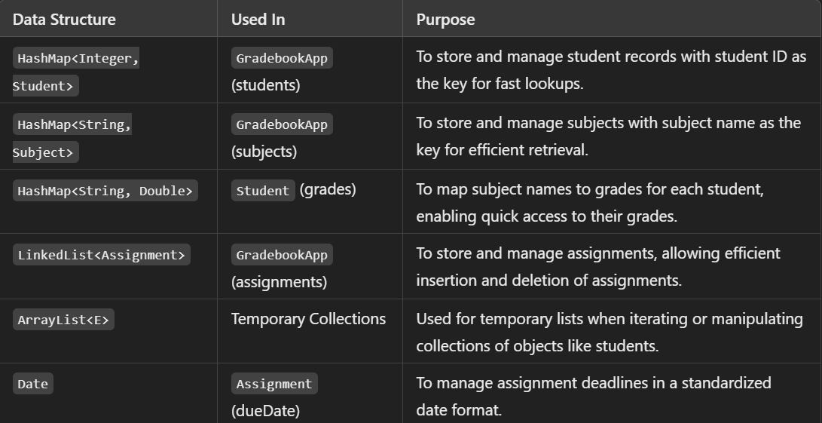
DATA STRUCTURES USED

Slide 7
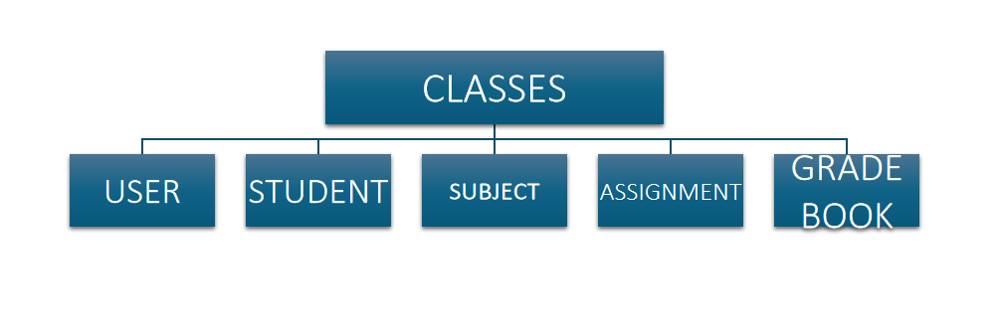
CLASSES USED-

Slide 8
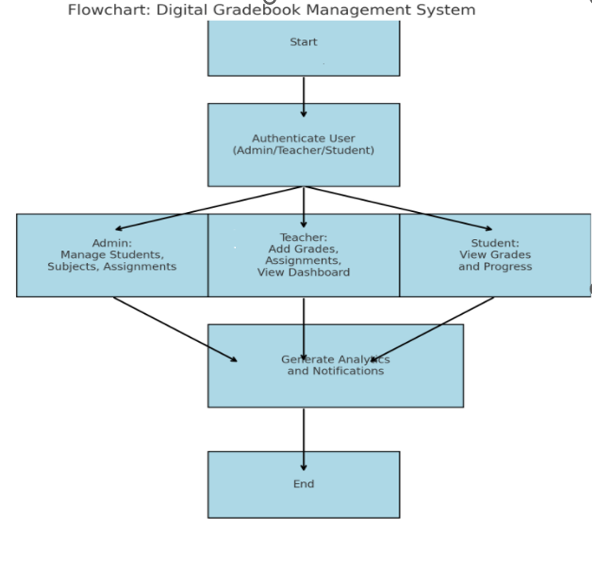
FLOWCHART

Slide 9
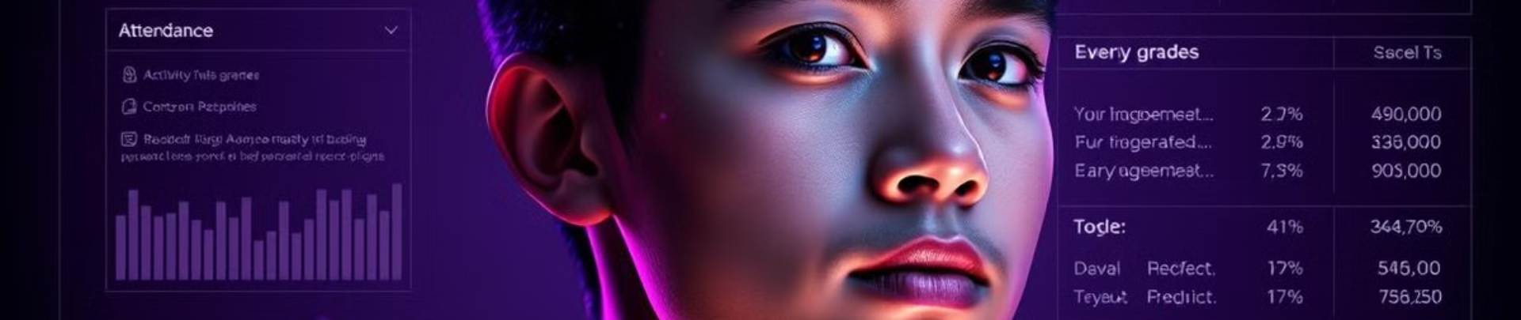
ADVANTAGES
Efficient Data Management: Stores and organizes student records, grades, assignments, and subjects in one system.
Role-Based Access: Admin, Teacher, and Student roles ensure appropriate permissions and security.
Customizable Grading: Supports different grading schemes (e.g., weighted averages, letter grades).
Real-Time Updates: Allows teachers to record grades and update information instantly.
User-Friendly: Simple interface for viewing grades, assignments, and generating reports.

Slide 10

FUTURE SCOPE
AI-Based Analytics: Integrate AI to predict student performance, identify at-risk students, and suggest personalized learning paths.
Automated Notifications and Alerts: Implement automatic notifications for students and teachers about deadlines, grade updates, and attendance concerns.
Integration with LMS (Learning Management Systems): Link with other educational platforms for seamless course management and content delivery.
Enhanced Reporting: Provide advanced reporting features like visual dashboards, charts, and grade distribution analysis for teachers and admins.

Slide 11
THANK YOU

